Slide 1
Threat Modelling with Enterprise Architecture
Designing with Security in Mind
presented by Fuli Fuli
BTECH 451 Project(2016)

Slide 2
ABSTRACT
This project aims to produce a process that allows enterprise architects to design with security in mind. The motivation for the project is twofold.
1) Allows security teams and architects to gain insight into the latent threats and vulnerabilities present in an architecture design via threat modelling
2) Improves the architectural process. The use of threat modelling early in the design stages allows vulnerabilities to be addressed early on and enables amendments to the design where necessary.
Why is it important to address vulnerabilities in the early stages of a design process?
Answer: The consequences of faults in designs found after deployment are inherently difficult and expensive to fix.
- I will be using a solution architecture called the "Final Grading Tool"(FGT) as a case study where threat modelling is used to understand the threats to this system.
-Threat modelling will analyse the FGT. Weaknesses an attacker might exploit in the architecture will be enumerated and filed. The results of this case study can be applied generally to future architectural design processes.

Slide 3
Brief Recap of 1st Seminar
Abstract
ITS- The Company
1) What is Enterprise Architecture?
2) What is the Final Grading Tool?
3) What is Threat Modelling? (recap of first seminar)
End Goal of Project- 3 Objectives

Slide 4
ITS- Information Technology Services
-Work at central IT on Symonds Street
Operational Security (in IT Services)
Enterprise Architecture (in IT Strategy, Policy and Planning)
- ITS looks after everything to do with University internet related business (Canvas, Internet Security etc)

Slide 5
1) What is Enterprise Architecture?
Enterprise architecture (EA) is a discipline for proactively and holistically leading enterprise responses to disruptive forces by identifying and analyzing the execution of change toward desired business vision and outcomes.
What is Solution Architecture? A solution architecture (SA) typically applies to a single project or project release, assisting in the translation of requirements into a solution vision, high level business and/or IT system.

Slide 6
Solution Architecture and my Project.
Solution Architects work within the Enterprise Architecture Team. They are more focused on a particular business problem within the organisation. It has a narrower scope.
Solution Architecture relates to my project as I will be using one of these solutions called “Final Grading Tool” as a test case for Threat Modelling.
They create high level design/solutions- single feature/ scenario
Ie: Exam Script Returns, Online Evaluation Forms, Online Enrolment etc.

Slide 7
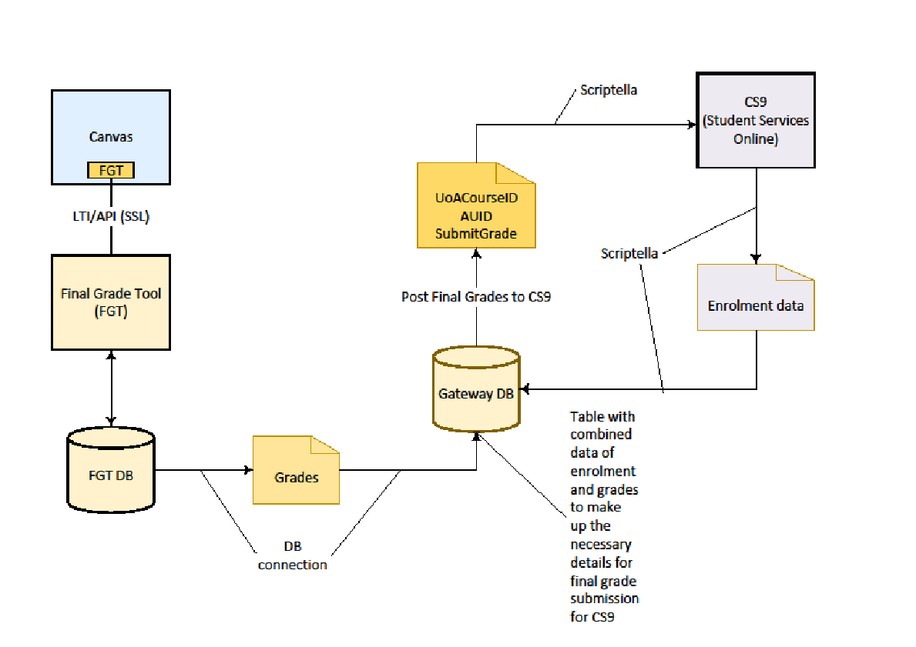
Example of High Level Design: “Final Grading Tool”
FGT

Slide 8
2) What is the “Final Grading Tool”
Used by the UOA to transfer Student Grades from lecturers, to exam office to the Student via SSO(Student Services Online).
Student grades are the lifeblood of the university. Hence it is important that as the information traverses from lecturer to student that there is data integrity and confidentiality in the process.
Furthermore, repudiation checks must be made at each end of the communication chain.

Slide 9
What are the dangers if FGT is compromised?
Student intercepts data, changes grades from D+ to A+ or vice versa
Malicious agent can change entire class grades, cause havoc or celebration (Depends on the grade).
In Russia, a hacker known as “Russian Robin Hood” upgraded an entire classes grades to A+. Went undetected for years as class did not report the incident. The university kept it quiet to preserve their reputation.
Also concerns with confidentiality. Malicious agent could leak grades to the public or social media (Max Key-John Keys son prime target).

Slide 10
Conventional Security Testing
Conventional security testing uncovered 9 security threats to the FGT system
Exact details are confidential : What I can say is:
It is possible to retrieve some assignment details through the Grade Book Tool for courses that a user has no access to in Canvas. (Information Disclosure).(HIGH)
Changes made directly on the Grade-book database are not logged. For instance, if an admin user changes a student's grade directly within the database, ….., no logs containing these changes would be available. (HIGH)
It is possible for users to modify grade details for courses they are not authorized to access. Furthermore, these modifications can be persisted directly into the database without invoking the final grade submission process.(HIGH)

Slide 11
STRIDE gap analysis- The BIG Question.
Could these 9 vulnerabilities have been prevented with Threat Modeling? STRIDE based gap analysis will answer this.
STRIDE BASED gap analysis- We threat model the FGT and compare results. Aiming for ideal threat model as defined later in slides.
Challenges- High level design abstracts physical details/ no low level detailed counterpart to refer to at ITS.
Getting the model right is difficult. How much do we abstract?
Threat modeling is in the process of transitioning from an art to a science though automation and the development of industry-standard best practices(Reef Dsouza).

Slide 12
Quick Rundown of STRIDE
S.T.R.I.D.E | MEANING | Examples
Spoofing | Impersonating something or someone else. | Attacker pretending to be a student or another student to gain access.
Tampering | Modifying data or code | Attacker intercepting data “man in the middle” attack or changing data in the FGT database.
Repudiation | Claiming to have not performed an action. | Attacker illegally making changes or viewing grades and claiming they haven’t.
Information Disclosure | Exposing information to someone not authorized to see it | Attacker being able to view other students grades.
Denial Of Service | Deny or degrade service to users | Attacker overloading server to deny students access to SSO or lecturers access to FGT
Elevation Of Privilege | Gain capabilities without proper authorization | Attacker illegally gain access to students account and then changing username/password.

Slide 13
3) What is Threat Modelling? Threat modelling is a process by which potential threats can be identified, enumerated, and prioritized – all from a hypothetical attacker’s point of view (Wikipedia, nd) Threat Modelling gives the user insight into the vulnerabilities in a design architecture and categorises threats so amendments can be made When is best time to threat model? Answer: The early design phases. The earlier you begin, the easier and more inexpensive it will be to fix. Research shows that worst time to inject security is when you are about to deploy. Security traditionally tacked on after design process complete.

Slide 14
How do we threat model?
-Multiple ways to threat model
Use Data Flow Diagrams
Include processes, data stores, data flows
Include trust boundaries
This project will be using STRIDE per element
Will discuss in detail later in presentation
1.
MODEL
Threat Model Process
4.
Validate
2.
Identify Threats
3.
Mitigate

Slide 15
Microsoft Threat Modelling Tool- STRIDE
-Give quick few minutes demonstration of it via laptop:
Why choose this threat model option:
It is similar type of work to model as SA high level design
- “Gliffy”- A collaborative drawing tool.
- It auto-generates & categorises threats for you. The only tool that does this.
Solution architects do not need to have extensive security knowledge to use it. Mitigations are pretty standard for each STRIDE threat.
- It is free!

Slide 16
STRIDE: Ready made mitigations for ease of use
STRIDE- Threats | What we want | Mitigations
Spoofing | Authentication | Cookie Authentication SSL/TLS Kerberos Authentication
Tampering | Integrity | ACLs Digital Signatures
Repudiation | Non-Repudiation | Secure Logging/Audit Digital signatures
Information Disclosure | Confidentiality | Encryption ACLs
Denial Of Service | Availability | ACLs, Filtering, Quotas
Elevation of Privilege | Authorisation | ACLs, Group or Role membership

Slide 17
Who does Threat Modelling?
-For this project, threat modelling is done during the design, and results in changes to a systems design.
-Nick Malik, a respected enterprise architect, says “In this context, Threat Modelling is a Solution Architecture or Security Architecture activity”.
Responses: Mitigation
Choose whether to respond to Threat
Choose technique to mitigate threat (redesign or encrypt etc.)
Choose appropriate technologies (TLS, HTTPS etc.)

Slide 18
End Goals of Project: 1st Objective
Produce a process that allows enterprise architects to design with security in mind. I aim to achieve this by:
1) Threat modelling with the FGT to uncover latent threats and vulnerabilities in the design not already addressed by conventional security testing or the infrastructure.
2) Research and compare and contrast various threat model alternatives and select the best one.
3) If threat modelling is effective, find a way to fit it seamlessly into the already established solution architecture process.

Slide 19
IDEAL THREAT MODEL
Security Testing
Threat Modeling
Infrastructure
Universe of Security Vulnerabilities

Slide 20
IDEAL THREAT MODEL
A Threat Model does not introduce non-existent vulnerabilities
An efficient infrastructure does not provide protection against non-existent vulnerabilities
Threat model requirements
All identified threats are real
A threat model improves on security testing
A strong threat model identifies security vulnerabilities not tested and not covered by the infrastructure

Slide 21
RESULT:
Used multiple cuts of the model beginning with a very low level high detail model. 78 threats in total found but getting non-existent threats.
Iteratively abstract pieces of model to try and make non-existent threats disappear with limited success. 8 cuts in total. Possible quirk of Microsoft TM tool is it retains old threats in memory.
Security team oversees 1st cut and we find two possible vulnerabilities not solved by infrastructure or picked up by conventional security.
Conclusion: Threat modeling will enable predictable threats to be picked up in design- (Quickly show 1st cut of threat model and report).

Slide 22
Microsoft TM Limitations
Great for assessing predictable threats but will not find threats that come out of “left field” (Nick Malik) Unpredictable threats.
Process is tedious, frustrating and quite difficult if have no access to exact details of physical implementation (low level design).
This is typical in big organizations where such information is highly compartmentalized (no-one has the whole picture) , especially when there is no “business need” for it to be commonly shared knowledge (unlike the high level designs).

Slide 23
End Goal of Project: 2nd Objective
produce a process that allows enterprise architects to design with security in mind. I aim to achieve this by:
1) Threat modelling with the FGT to uncover latent threats and vulnerabilities in the design not already addressed by conventional security testing or the infrastructure.
2) Research and compare and contrast various threat model alternatives and select the best one.
3) If threat modelling is effective, find a way to fit it seamlessly into the already established solution architecture process.

Slide 24
SeaSponge- Alternative TM Tool
Advantages over Microsoft Tool:
Platform independent & Free
Open Source
Generic connections applicable to any system (Not just Microsoft).
Disadvantages:
User must generate own threats
Hence requires security knowledge to use effectively

Slide 25
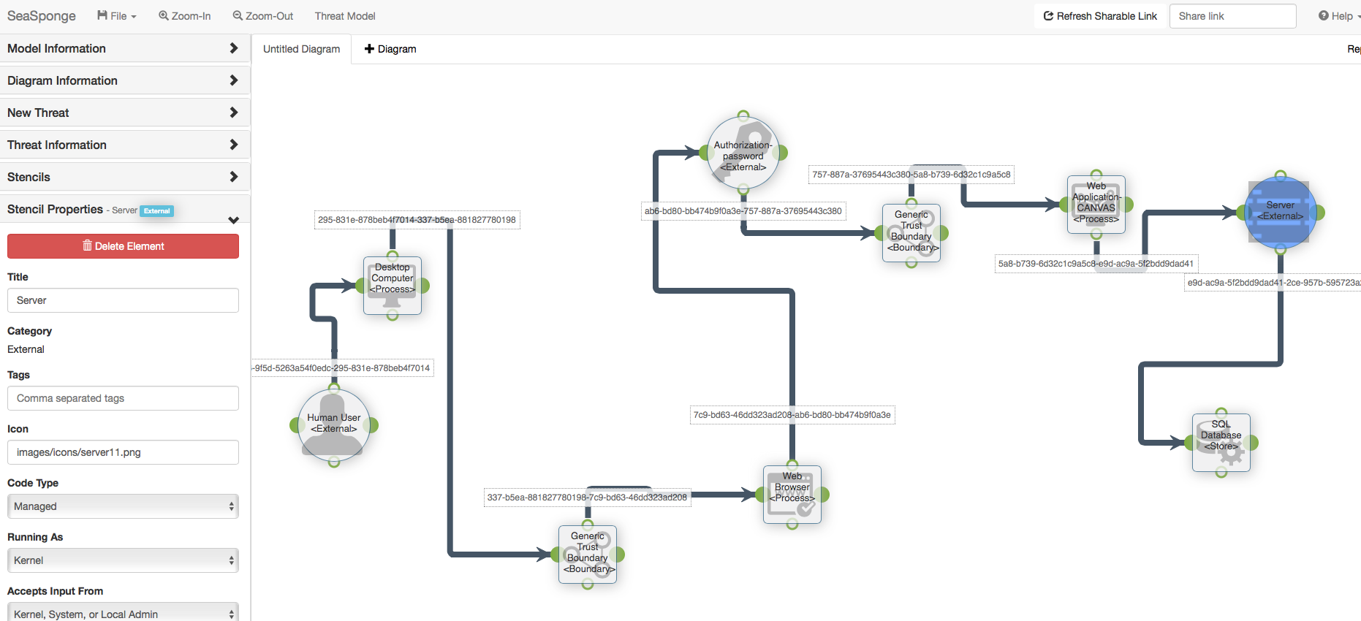
SeaSponge Diagram

Slide 26
3rd party “Threat Modeller” Service
http://threatmodeler.com
Advantages over Microsoft tool:
-Service promises quantifiable improvement in security, high scalability
Up to 75% increased security
Reduces costs of fixing vulnerabilities by 70%
Disadvantages:
Not sure how they quantify these figures- Just Marketing?
Paid Third Party Service

Slide 27
DREAD (Alternative to STRIDE catergorization)
Besides STRIDE we also have other threat evaluation models like DREAD
DREAD is a classification scheme for quantifying, comparing and prioritizing the amount of risk presented by each evaluated threat
Can be used in conjunction with Attack Trees (ex: Guessing password highly improbable so no need to consider).
More in line with business needs. Strikes Balance between security and Goals.
DREAD = (DAMAGE + REPRODUCIBILITY + EXPLOITABILITY + AFFECTED USERS + DISCOVERABILITY) / 5

Slide 28
DREAD
Damage Potential(1-10)- Measure of damage
Reproducibility(1-10)- Measure of how easy it is to work
Exploitability(1-10)- Measure of effort and expertise required
Affected Users(1-10)- Measure of percentage of Users affected
Discoverability(1-10)- Measure of how easy it is to find
Risk/DREAD = average score. 10 being highest risk- 1 being lowest risk

Slide 29
DREAD Limitations
Scores can be seen as highly subjective
Security conscious people tended to rank everything high, making most threats a 10. Developers not focused on security tend to rate threats low (usually a 1 or 0).
This created a huge polarity in the reviewing process.
Some security experts declaring DREAD as DEAD by 2005 (Dan Sellers-Microsoft).
Probably not a good system for Security + Solution Architects to collaborate on.

Slide 30
End Goal Of Project- 3rd Objective
produce a process that allows enterprise architects to design with security in mind. I aim to achieve this by:
1) Threat modelling with the FGT to uncover latent threats and vulnerabilities in the design not already addressed by conventional security testing or the infrastructure.
2) Research and compare and contrast various threat model alternatives and select the best one.
3) If threat modelling is effective, find a way to fit it seamlessly into the already established solution architecture process.

Slide 31
Fitting Threat Modeling into Design Process
Architect threat models first draft of solution design via Microsoft Threat Modeling Tool
The tool generates and enumerates threats and highlights vulnerabilities in the design. Add pre-prepared mitigations into report. Frame a simple template in the Wiki to capture outputs
Security Team assesses which threats are already mitigated by the infrastructure (HTTPS, TLS/SSL etc.).
Architecture team discusses what amendments need to be made, if any. Maybe use DREAD or other risk analysis to decide which possible threats need mitigation, and which ones they can leave.
Pass back to security team for conventional security testing.

Slide 32
Barriers to Adoption of Process.
High level design problematic for threat modeling.
Threat modeling with Microsoft TM tool would be very simple if a detailed low level design (physical implementation) existed for every high level design created.
Perception is it could just create more work/ red-tape. “If it ain’t broke, don’t fix it” mindset is common.
Business concerns often trump security. Fast delivery of solution prioritised.
It’s a relatively unknown untried concept, even amongst most security teams. More of an art than a science at the moment (Reef Dsouza).

Slide 33
Making threat modeling viable
Educate teams on benefits of threat modeling (Nik Mallick http://vanguardea.com/enterprise-architecture-and-threat-modeling/ )
Automated tools increasingly making it easy to use- Microsoft tool at the moment leads the way.
ARCHIMATE is a visual modelling language that is emerging as a standard for enterprise architecture. It now has an add on threat model section incorporating threat modeling http://blog.bizzdesign.com/enterprise-architecture-based-risk-assessment-with-archimate
Make it fun- card game called “Elevation of Privilege” https://www.microsoft.com/en-us/sdl/adopt/eop.aspx

Slide 34
End of Presentation
Thanks for Listening!

Slide 35
Other Threat Models/ Categorizations
TRIKE also known as OCTOTRIKE- open source threat modeling tool. Also risk based. Has not been maintained since 2010.-Now exists as a spreadsheet. http://octotrike.org/tools.shtml
P.A.S.T.A (Process for Attack Simulation and Threat Analysis) -seven step risk assessment model, for aligning business objectives and technical requirements. More aimed at coding applications.
FAIR (Factor Analysis of IT and Information Risk)
IRIUS RISK https://iriusrisk.continuumsecurity.net Another commercial third Threat Model Service.

Slide 36
Simple DFD example: Processes Talking across a network always have a trust boundary
Blue Line = Trust Boundaries intersect orange data flows
Customer PC
Web Server
Database

Slide 37
Corporate TM “SecurITree”
http://www.amenaza.com/index2.php
Advantages:
Offers service that promises to think like the attacker
Uses attack trees library
Disadvantages:
Paid Third Party Service
Costly

Slide 38
What are Attack Trees?
Threat 1.
Attacker spoofs a student to gain access to UOA grades
1.1 Social engineering- shoulder surf
1.1.1
Gains access to UOA details.
1.1.2
Gains access and changes password. Elevation of Privilege.
1.2 Gets lucky-guesses password
1.2.1
Gains access to UOA details.

